Slide 1
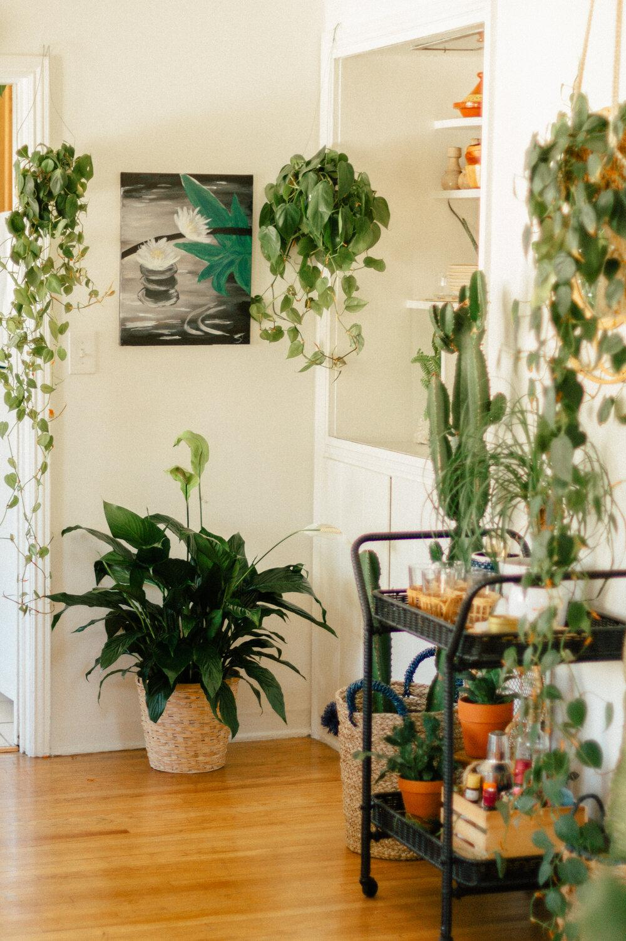
MODERN
INDOOR PLANTS
TerminalX Technologies

Slide 2
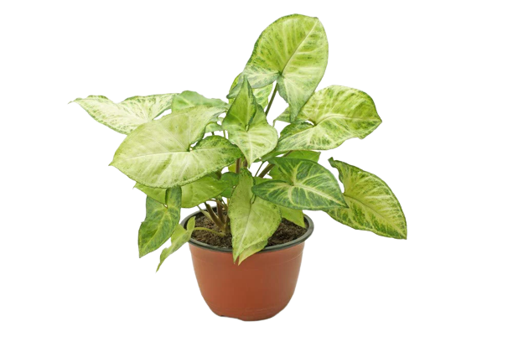
— Syngonium Plant
Syngonium plants are not just decorative, they have the ability to cleanse the air you, breathe and act as anti-pollutants. These plants can reduce components of indoor air pollution, even volatile organic compounds such as benzene, formaldehyde,
toluene, and xylene.

Slide 3
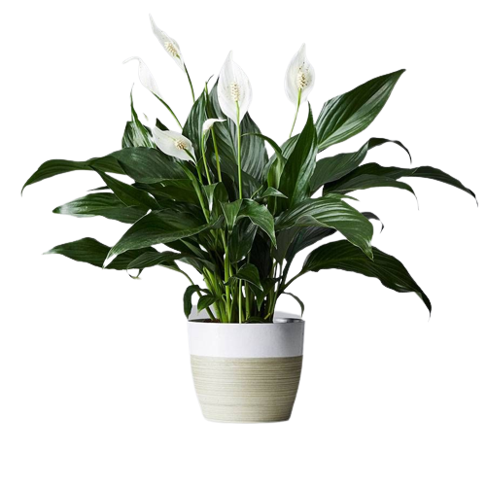
— peace lily Plant
The peace lily plant is well known for its air-purifying abilities as a houseplant; it's great at breaking down and neutralizing toxic gases like carbon monoxide and formaldehyde.

Slide 4
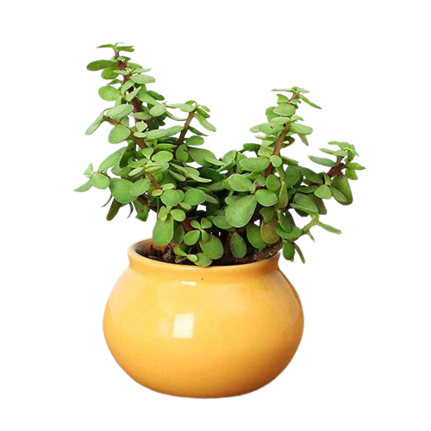
— JADE Plant
It Improves Indoor Air Quality
It Increases Humidity
A Good Luck Symbol
It Absorbs CO2 in the Night
Extract from its leaves is used to treat wounds, stomach upset, warts, and diabetes.

Slide 5
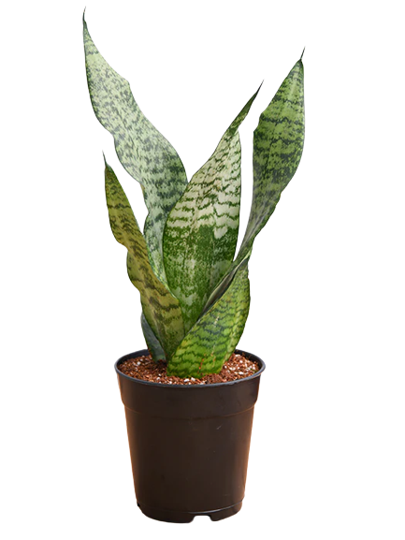
— sansevieria Plant
Filter indoor air.
Remove toxic pollutants.
May help boost mental health.
Easy to care for.
Effective against allergies.
May help enhance the “energy” of a space, according to feng shui.
Can help with minor ailments.

Slide 6
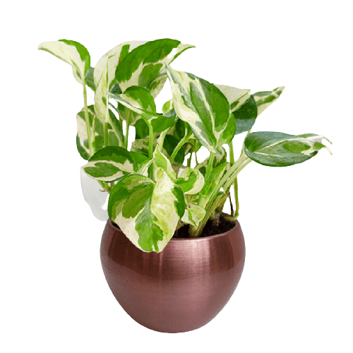
— money Plant
Purifies Air.
Reduces Stress & Anxiety.
Acts as an Anti-radiator.
Offers Health Benefits.
Keeps Marital Problems Away.
Brings Prosperity & Good Luck.
Mends Broken Relationships.
Spreads Positivity.

Slide 7
Thank You
TerminalX Technologies

